Slide 1


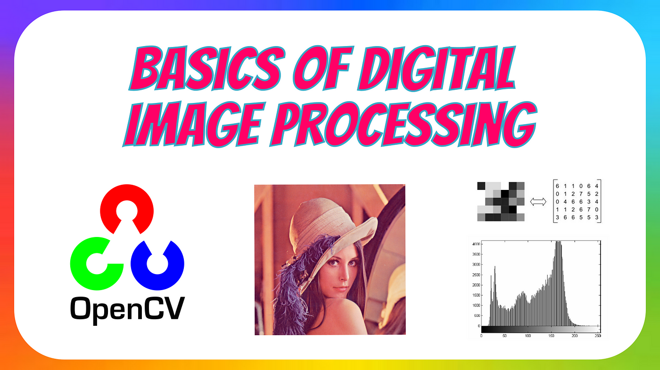
Session 2 :
Understanding Digital Images

Slide 2
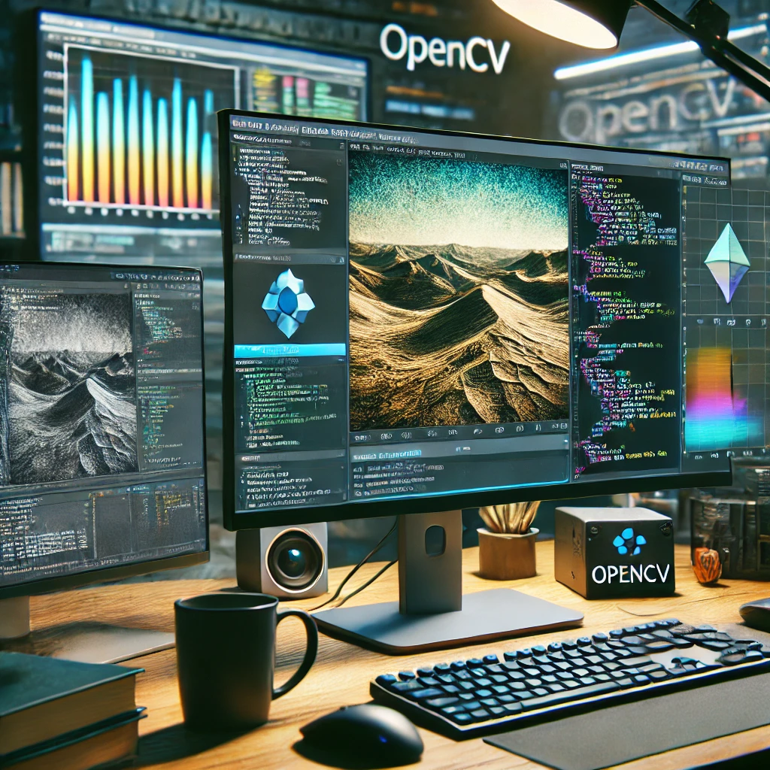
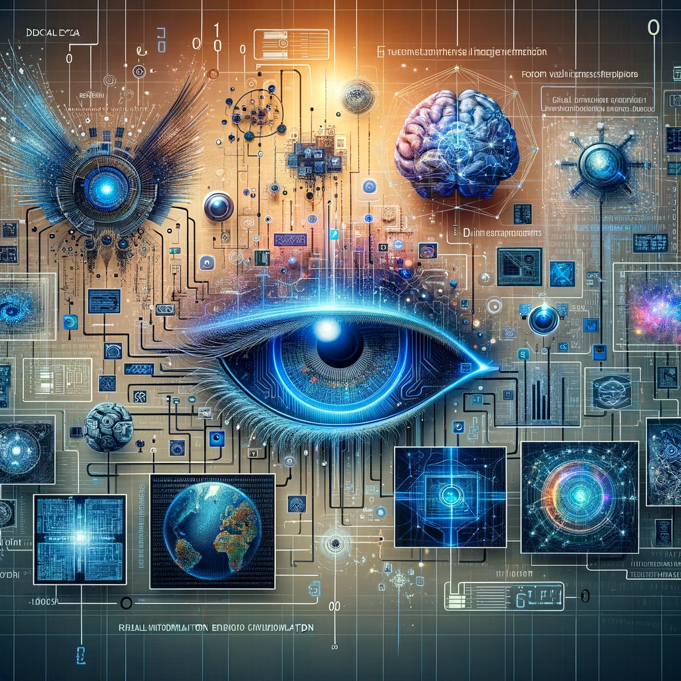
Understanding Digital Images

Slide 3
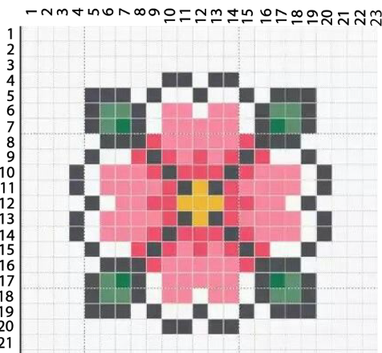
What is a Digital Image in OpenCV?
A digital image is made up of tiny squares called pixels that store color or brightness information. When these pixels are arranged in a grid, they form an image that can be displayed on a screen. OpenCV, a powerful computer vision library, helps in processing these digital images to extract useful information, enhance quality, or detect objects.
Pixels: Let’s start with the ‘Pixel’. Generally, images are composed of pixels, or “picture elements,” which serve as the core units. Each pixel represents vital information about color and brightness, collectively forming the visual representation. In grayscale images, a pixel’s intensity value denotes its brightness on a scale from 0 (black) to 255 (white) within an 8-bit system. For colored images, pixels contain information for three primary color channels: Red (R), Green (G), and Blue (B), with each channel’s intensity ranging from 0 to 255. Different combinations of these values produce a diverse spectrum of colors. For instance, full intensity in all channels (255, 255, 255) results in white, while no intensity in any channel (0, 0, 0) yields black. This is the very fundamental understanding of pixel intensity for image representation and processing in the digital domain.

Slide 4
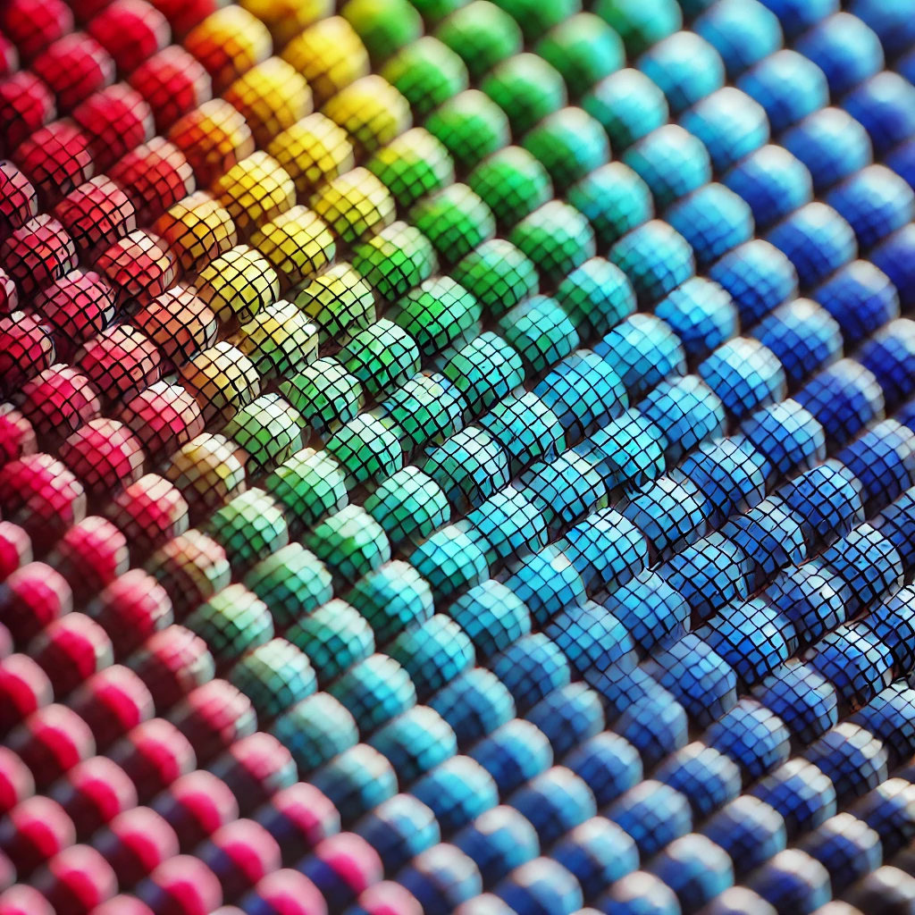
Digital images have 3 major components:
1. Size: Size denotes the height and width of an digital image, which is measured by the number of pixels.
2. Color space: It represents various conceivable color spaces, including Grayscale, RGB, and HSV. The image of the duck is depicted in the RGB color space.
3. Channels: This explains the attributes of a color space — For example, RGB has three color channels: Red, Green, and Blue.

Slide 5

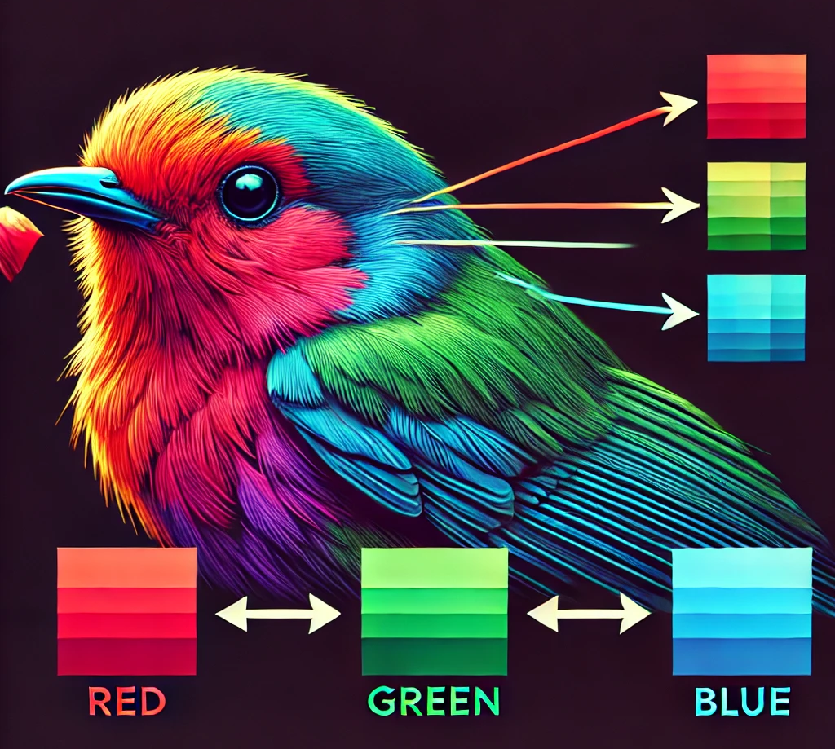
The separate images of the Red (R), Green (G), and Blue (B) channels extracted from the RGB representation of the duck below:
RGB Color Scheme: The RGB color model,widely utilized in digital devices and displays, derives its name from the primary additive colors: Red, Green, and Blue. In this model, colors are formed through the combination of varying intensities of these three primary hues. Each channel (R, G, B) has an intensity range from 0 to 255, offering a staggering 16.8 million possible color variations (256³).

Slide 6
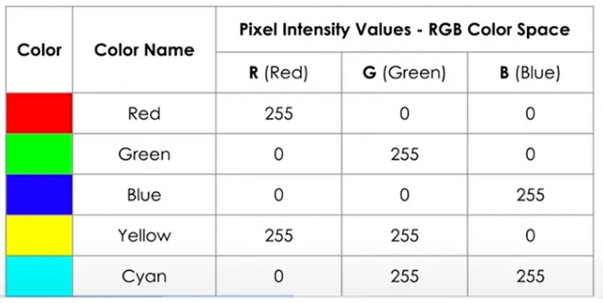
The higher the pixel intensity value, the more the brightness of the color.

Slide 7
Understanding RGB :
Red (R): Controls the presence of red light in the color spectrum. Maximum intensity (255, 0, 0) yields pure red, while absence (0, 0, 0) results in black.
Green (G): Dictates the degree of green light. Full intensity (0, 255, 0) produces pure green, while no intensity (0, 0, 0) leads to black.
Blue (B): Controls the amount of blue light. Maximum intensity (0, 0, 255) produces pure blue, while absence (0, 0, 0) results in black.By mixing different amounts of these main colors, we can create a wide range of shades, from bright and lively to more subtle tones. For example, combining full red (255, 0, 0) with full green (0, 255, 0) gives us yellow (255, 255, 0). When red, green, and blue are equally intense (255, 255, 255), we get white. When there’s no intensity in any channel (0, 0, 0), we get black. This model forms the basis for the rich palette of digital colors.

Slide 8
Pixel Grid
What is a Pixel Grid? A pixel grid is a 2D matrix (or array) of pixels that forms the structure of a digital image. Each pixel in the grid corresponds to a specific location in the image and contains information about its color or intensity.
Structure of a Pixel Grid:
The grid is organized into rows and columns.
The number of rows and columns determines the resolution of the image.
For example, an image with a resolution of 1920x1080 has 1920 columns (width) and 1080 rows (height), totaling 2,073,600 pixels.
Visual Representation: Imagine a chessboard where each square is a pixel. The entire board represents the pixel grid of an image.
Example of a 3x3 Pixel Grid:
[ [P1, P2, P3],
[P4, P5, P6],
[P7, P8, P9] ]

Slide 9
1. What is a Pixel Value?
A pixel value is a number (or set of numbers) that represents the color or intensity of a pixel in a digital image.
The range and meaning of the value depend on the color mode of the image (e.g., grayscale, RGB, binary).
2. Pixel Values in Different Color Modes
a. Grayscale Images
Grayscale images are one of the simplest and most commonly used types of digital images. They represent visual data using shades of gray, ranging from black to white. Let’s explore grayscale images in detail, focusing on their pixel values and how they work.
1. What is a Grayscale Image?
A grayscale image is a digital image where each pixel represents only the intensity or brightness of light, without any color information.
The term "grayscale" refers to the range of shades of gray, from pure black to pure white.
2. Pixel Values in Grayscale Images
In grayscale images, each pixel has a single value representing its brightness.
The value typically ranges from 0 to 255 (for 8-bit images):
0: Represents pure black (minimum intensity).
255: Represents pure white (maximum intensity).
Values in between represent shades of gray.

Slide 10
Example of a 3x3 Grayscale Image:
[ [100, 150, 200],
[50, 255, 100],
[0, 75, 25] ]
Here, 100 is a mid-gray pixel, 255 is white, and 0 is black.
3. How Grayscale Images are Created
Grayscale images are often derived from color images by converting the color information into a single intensity value. Common methods for grayscale conversion:
Luminous method
Average Method
Luminous method:The luminosity method is a technique used to convert a color image (RGB) into a grayscale image. Unlike simple averaging, this method takes into account the human eye's sensitivity to different colors, ensuring that the grayscale image accurately reflects the perceived brightness of the original color image.
The luminosity method calculates the grayscale value of a pixel by taking a weighted average of its red (R), green (G), and blue (B) components.
The weights are based on how sensitive the human eye is to each color:
The eye is most sensitive to green, followed by red, and least sensitive to blue.
The formula for the luminosity method is:

Slide 11
The formula for the luminosity method is:
Grayscale = 0.299 * R + 0.587 * G + 0.114 * B
Here, R, G, and B are the red, green, and blue values of the pixel, respectively.
Why Use the Luminosity Method?
Human Perception:
The human eye perceives green light as brighter than red or blue light. The luminosity method accounts for this by giving green the highest weight.
Accuracy:
The resulting grayscale image more accurately reflects the perceived brightness of the original color image compared to simple averaging.
Standard Practice:
The luminosity method is widely used in image processing and computer vision applications.
Average Method:
The average method is one of the simplest techniques used to convert a color image (RGB) into a grayscale image. It calculates the grayscale value of a pixel by taking the average of its red (R), green (G), and blue (B) components. While straightforward, this method does not account for the human eye's sensitivity to different colors, which can result in grayscale images that appear less natural compared to those produced by the luminosity method.

Slide 12
Average Method:
The average method is one of the simplest techniques used to convert a color image (RGB) into a grayscale image. It calculates the grayscale value of a pixel by taking the average of its red (R), green (G), and blue (B) components. While straightforward, this method does not account for the human eye's sensitivity to different colors, which can result in grayscale images that appear less natural compared to those produced by the luminosity method
1. What is the Average Method?
The average method calculates the grayscale value of a pixel by averaging its red, green, and blue components.
The formula for the average method is:
Grayscale = (R + G + B) / 3
Here, R, G, and B are the red, green, and blue values of the pixel, respectively.
2. Why Use the Average Method?
Simplicity:
The average method is easy to understand and implement, making it a good starting point for grayscale conversion.
Uniform Treatment of Colors:
All color channels (R, G, B) are treated equally, which can be useful in certain applications where color balance is important.

Slide 13
Average Method:
The average method is one of the simplest techniques used to convert a color image (RGB) into a grayscale image. It calculates the grayscale value of a pixel by taking the average of its red (R), green (G), and blue (B) components. While straightforward, this method does not account for the human eye's sensitivity to different colors, which can result in grayscale images that appear less natural compared to those produced by the luminosity method
1. What is the Average Method?
The average method calculates the grayscale value of a pixel by averaging its red, green, and blue components.
The formula for the average method is:
Grayscale = (R + G + B) / 3
Here, R, G, and B are the red, green, and blue values of the pixel, respectively.
2. Why Use the Average Method?
Simplicity:
The average method is easy to understand and implement, making it a good starting point for grayscale conversion.
Uniform Treatment of Colors:
All color channels (R, G, B) are treated equally, which can be useful in certain applications where color balance is important.

Slide 14
Common Image Formats:
Image formats are standardized means of organizing and storing digital images. Different formats are optimized for various purposes, such as compression, quality, transparency, and compatibility. Here's an overview of some common image formats:
1. Raster Image Formats
Raster images are made up of pixels, where each pixel has a specific color and position. These images are resolution-dependent, meaning they lose quality when scaled up. Below are some common raster image formats used in image processing:
GIF (Graphics Interchange Format)
Use Case: Simple animations, low-color images.
Compression: Lossless.
Pros: Supports animation, small file size for simple images.
Cons: Limited to 256 colors, not suitable for high-quality images.
BMP (Bitmap)
Use Case: Windows applications, simple graphics.
Compression: Uncompressed or lossless.
Pros: High quality, no compression artifacts.
Cons: Large file size, not web-friendly.

Slide 15
TIFF (Tagged Image File Format)
Use Case: High-quality printing, professional photography.
Compression: Lossless or lossy.
Pros: High quality, supports layers and transparency.
Cons: Large file size, not web-friendly.
WebP
Use Case: Web images, modern applications.
Compression: Lossy or lossless.
Pros: Smaller file size than JPEG and PNG, supports transparency and animation.
Cons: Not universally supported by older browsers.
HEIC/HEIF (High Efficiency Image Format)
Use Case: Apple devices, modern photography.
Compression: Lossy or lossless.
Pros: High quality with small file size, supports transparency.
Cons: Limited compatibility outside Apple ecosystem.

Slide 16
GIF (Graphics Interchange Format)
Use Case: Simple animations, low-color images.
Compression: Lossless.
Pros: Supports animation, small file size for simple images.
Cons: Limited to 256 colors, not suitable for high-quality images.
BMP (Bitmap)
Use Case: Windows applications, simple graphics.
Compression: Uncompressed or lossless.
Pros: High quality, no compression artifacts.
Cons: Large file size, not web-friendly.
Example: Loading and Displaying a Raster Image in OpenCV:

Slide 17
Here, we are going to load an image in one of the raster formats, such as JPEG, PNG, GIF, BMP, TIFF, or WebP. Below is the code for this.
Code
import cv2 # Import OpenCV
# Load the image
image = cv2.imread(r"C:\Users\OMOLP047\Downloads\photo.png") # Ensure the image file is in the same directory
# Display the image
cv2.imshow("Raster image", image)
# Wait until a key is pressed
cv2.waitKey()
# Close all OpenCV windows
cv2.destroyAllWindows()

Slide 18
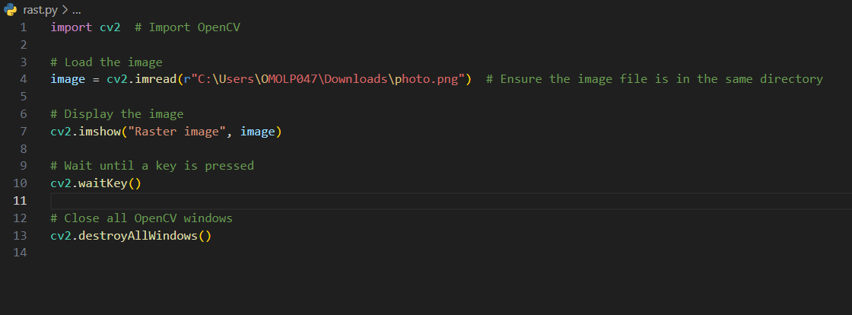
NOTE: Ensure on line number 4, ensure that you provide the correct file path along with the appropriate image extension.

Slide 19
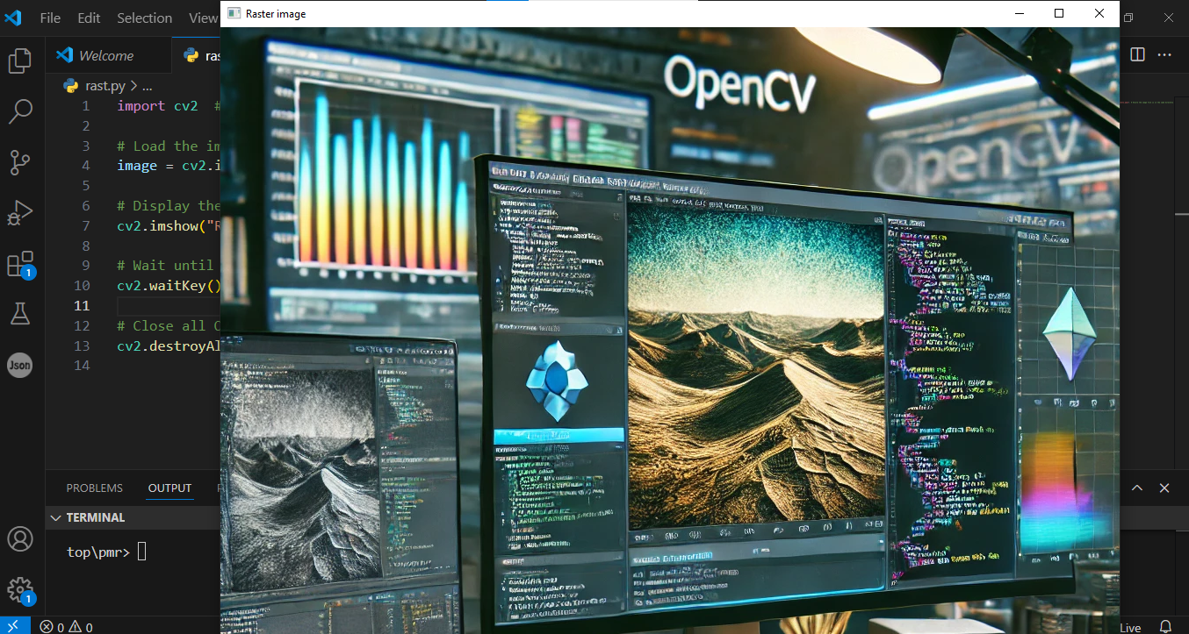
Output:

Slide 20
2. Vector Image Formats
Vector images are made up of paths and shapes, making them resolution-independent. They are ideal for logos, icons, and illustrations.
SVG (Scalable Vector Graphics)
Use Case: Web graphics, logos, icons.
Compression: Lossless.
Pros: Scalable without quality loss, small file size, editable with code.
Cons: Not suitable for complex images like photographs.
AI (Adobe Illustrator)
Use Case: Professional graphic design.
Compression: Lossless.
Pros: High quality, supports layers and complex designs.
Cons: Requires specialized software to edit.
EPS (Encapsulated PostScript)
Use Case: Print design, vector graphics.
Compression: Lossless.
Pros: Compatible with many design tools, scalable.
Cons: Larger file size, not ideal for web use.

Slide 21
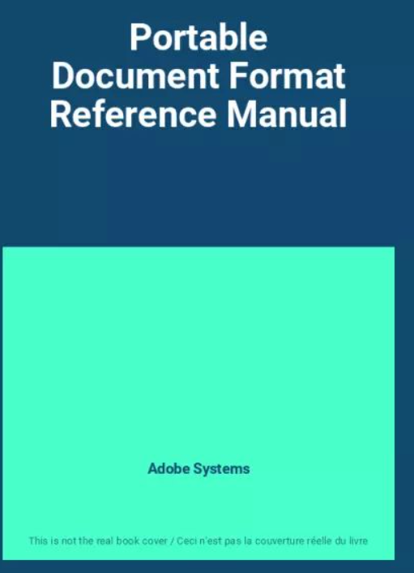
PDF (Portable Document Format)
Use Case: Documents, vector graphics.
Compression: Lossless.
Pros: Preserves layout and quality, widely supported.
Cons: Not optimized for web graphics.
Example:

Slide 22
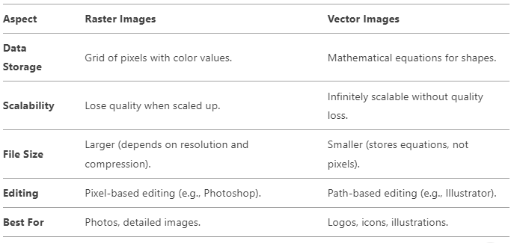
Comparison of Raster and Vector Storage

Slide 23
How Compression Affects Storage
Raster Images:
Lossless compression (e.g., PNG): Preserves all pixel data.
Lossy compression (e.g., JPEG): Discards some data to reduce file size.
Vector Images:
No compression needed for scalability, but files can be compressed (e.g., SVGZ is a compressed SVG format).
What is Metadata in Images?
Metadata is like a hidden note inside an image file. It’s not part of the actual picture (the pixels or shapes you see), but it gives you extra information about the image. Think of it as a label on a photo that tells you more about it.
What Kind of Information is in Metadata?
Here are some examples of what metadata can tell you:
When and Where:
When the photo was taken.
Where it was taken (if the camera or phone has GPS).
How It Was Taken:
Camera settings like shutter speed, aperture, and ISO.
What type of camera or phone was used.

Slide 24
Who Made It:
The name of the photographer or artist.
Copyright information (who owns the image).
What’s in the Image:
A title or description of the image.
Keywords or tags (e.g., “beach,” “sunset,” “family”).
Editing Details:
If the image was edited in software like Photoshop.
What changes were made (e.g., brightness, contrast)
Where is Metadata Stored?
Metadata is stored inside the image file, but you can’t see it when you look at the picture. It’s like a secret part of the file that only certain tools or software can read.
Examples of Metadata in Real Life
Smartphone Photos:
If you take a photo with your phone, it might save:
The date and time.
The location (if GPS is on).
The phone model (e.g., iPhone 15).

Slide 25
Professional Photos:
A photographer’s camera might save:
Camera settings (e.g., shutter speed, aperture).
Their name and copyright info.
Edited Images:
If you edit a photo in Photoshop, it might save:
A history of the changes you made.
The software version used.
Why is Metadata Useful?
Organization:
Helps you find images quickly (e.g., search for “beach photos from 2023”).
Protection:
Adds copyright info to protect your work.
Editing:
Keeps track of changes so you can edit the image later.
Sharing:
Gives context to others (e.g., where and when the photo was taken).

Slide 26
Code to show how you can read, add, and remove metadata from image files.
Using Python and a popular library called Pillow (for basic metadata) and ExifTool (for advanced metadata).
1. Reading Metadata from an Image
We’ll use the Pillow library to read basic metadata from an image.
Install Pillow
pip install pillow
Code example
2. Import Required Modules
from PIL import Image
from PIL.ExifTags import TAGS
PIL (Python Imaging Library): Used for opening, manipulating, and saving images.
Image: A module from PIL that allows loading and processing image files.
ExifTags: Contains a dictionary of EXIF (Exchangeable Image File Format) metadata tags.
3. Load an Image
image = Image.open("example.jpg")

Slide 27
Image.open("example.jpg"): Loads an image file named example.jpg from the current working directory.
image: Stores the loaded image as a PIL image object.
4. Extract Basic Metadata
print("Image Format:", image.format)
print("Image Size:", image.size)
print("Image Mode:", image.mode)
image.format: Prints the file format (e.g., JPEG, PNG, BMP, etc.).
image.size: Prints the dimensions (width, height) of the image.
image.mode: Prints the color mode of the image (e.g., RGB, CMYK, Grayscale).
5. Extract EXIF Metadata (If Available)
if hasattr(image, "_getexif"):
hasattr(image, "_getexif"): Checks if the image contains EXIF metadata.
EXIF Data: Stores metadata like camera settings, timestamps, and GPS info.
exif_data = image._getexif()
image._getexif(): Extracts EXIF metadata as a dictionary (tag_id: value).
6. Iterate Through EXIF Metadata
if exif_data:
for tag_id, value in exif_data.items():
if exif_data:: Ensures that EXIF metadata exists before processing.
for tag_id, value in exif_data.items():: Loops through each metadata tag.

Slide 28
tag_name = TAGS.get(tag_id, tag_id)
TAGS.get(tag_id, tag_id): Converts numerical tag IDs into human-readable names using ExifTags.TAG.
print(f"{tag_name}: {value}")
Prints each metadata tag name along with its value.

Slide 29
TIFF (Tagged Image File Format)
Use Case: High-quality printing, professional photography.
Compression: Lossless or lossy.
Pros: High quality, supports layers and transparency.
Cons: Large file size, not web-friendly.
WebP
Use Case: Web images, modern applications.
Compression: Lossy or lossless.
Pros: Smaller file size than JPEG and PNG, supports transparency and animation.
Cons: Not universally supported by older browsers.
HEIC/HEIF (High Efficiency Image Format)
Use Case: Apple devices, modern photography.
Compression: Lossy or lossless.
Pros: High quality with small file size, supports transparency.
Cons: Limited compatibility outside Apple ecosystem.

Slide 30
Exercise
1. What is the basic unit of a digital image? A. Grid B. Frame C. Pixel D. Channel
Answer: C. Pixel
2. What does the intensity value of a pixel represent in a grayscale image? A. Image width B. Brightness level C. Color depth D. Image format
Answer: B. Brightness level

Slide 31
Exercise
3. Which of the following color spaces uses three channels: Red, Green, and Blue? A. Grayscale B. HSV C. Binary D. RGB
Answer: D. RGB
4. What is the formula used in the Luminosity method to convert an RGB image to grayscale? A. (R + G + B) / 3 B. R × G × B C. 0.299 × R + 0.587 × G + 0.114 × B D. 0.5 × (R + G)
Answer: C. 0.299 × R + 0.587 × G + 0.114 × B

Slide 32
Exercise
5. Which image format is best for storing high-quality images with optional lossless compression and supports layers and transparency? A. JPEG B. PNG C. TIFF D. BMP
Answer: C. TIFF

